Slide 1
Data Analytics in Student Success
Final Capstone
Evelyn Davis

Slide 2
TABLE OF CONTENTS
ABOUT ME
01
MOTIVATION
02
VIRTUALIZATION
03
STATISTICAL RESULTS
04
CONCLUSION
05
Background, job, interests
Purpose of the project, how important for the military
Data structure, and figures, virtualizing data
linear regression, logistic regression
Summary and future work

Slide 3
ABOUT ME
Name
Evelyn Davis
Background
Job
Curriculum Developer
Sergeant in the United States Space Force
Trained computer system programmer
Develop training curriculum for cyber
Degrees in computer science and math
Interests
Travel
Sport
Health
Music
Art
Tech

Slide 4
MOTIVATION
Purpose?
AETC mission:
Recruit, train, and educate exceptional Airmen.
Train and Educate:
Factors of the student academic performance
Relationship between students’ demographic features, academic background, and behavioral features.
How to improve training and education.
Notes:
Motivation and elevator pitch:
As a curriculum developer, my mission is supporting the Air Force Education and Training Command. We are focusing on recruit, train, and educate exceptional Airman. What are the factors of the student academic performance? Is there a relationship between students’ demographic features, academic background, and behavioral features? How can we improve our training and education in the department of the Air Force? In this capstone, I will use data virtualization, and statistical tools to review some of the key factors effecting students’ success and how to improve our students’ performance in training.

Slide 5
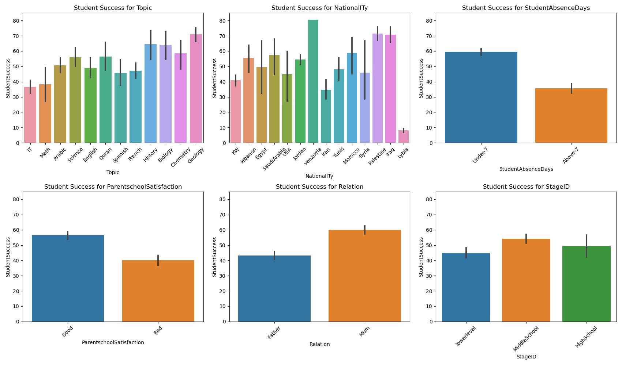

Slide 6
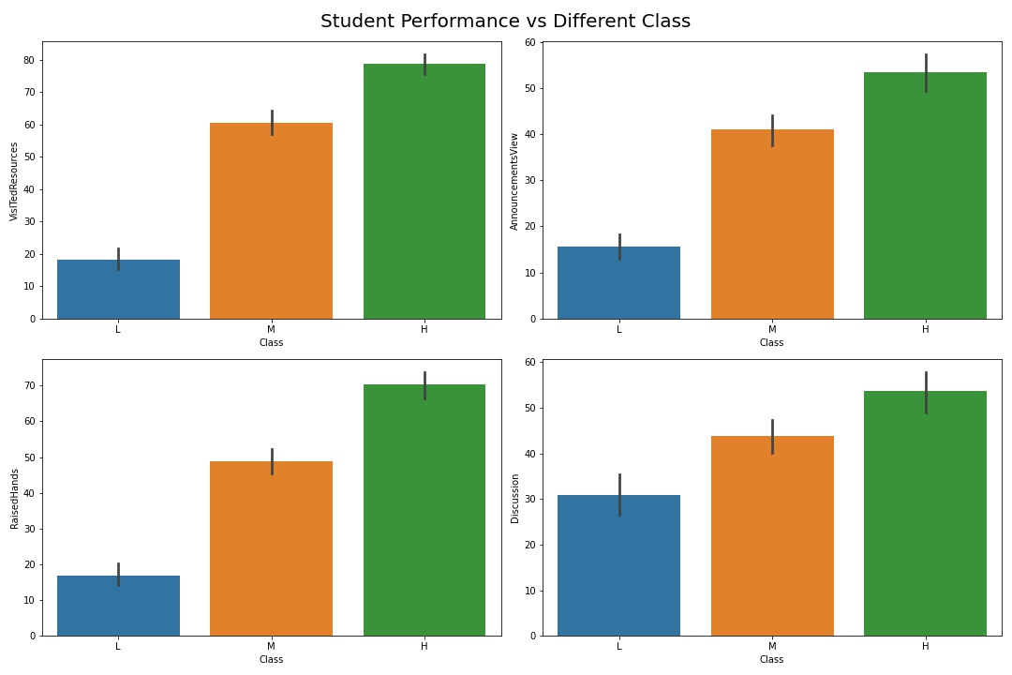

Slide 7
Regression Coefficients
Linear
Ridge
Lasso
Raised Hands
6.6368
6.5031
6.6184
Visited Resources
11.2121
8.7145
11.1561
Announcements View
4.7097
5.1695
4.6819
Discussion
6.6834
5.4469
6.6125
R^2
0.9771
0.9568
0.9768

Slide 8
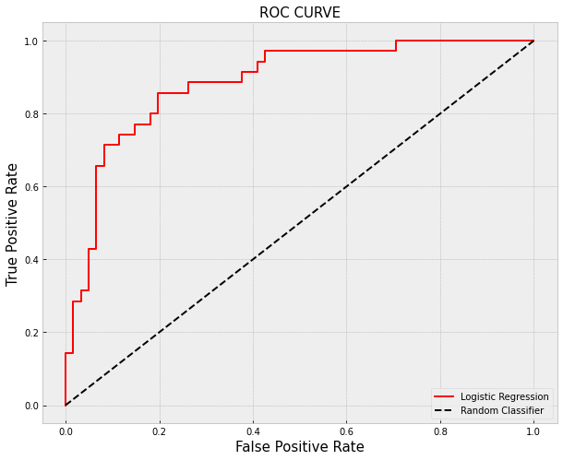
LOGISTIC REGRESSION
ROC Curve
Confusion Matrix
Raised Hands
Visited Resources
57
4
Announcements View
Discussion
12
23

Slide 9
SUMMARY
Demographic
Modeling
01
04
02
03
Parents Relations
Behavioural
US students stand in the middle with large standard deviation among other countries by student performance
Linear regression: R^2 0.9771
Logistic regression: ROC 88.5%
Students loser to Mother has better performance
Raise more hand, visited more resources, viewing more announcements, and discuss more in groups

Slide 10
FUTURE WORK
More data: The original data only has 480 instance and 16 attributes, collecting more data could improve accuracy.
Hypothesis testing: Welch two sample T-test, and Chi-squared test to see if student behaviour differ by demographic features.

Slide 11
THANKS
CREDITS: This presentation used template provided by Slidesgo, including icons by Flaticon, and infographics & images by freepik
Do you have any questions?
evelyn.davis.1l@spaceforce.mil
+1 228-377-0651
spaceforce.mil

